Slide 1
VLANs
LAN Switching and Wireless – Chapter 3

Slide 2
Objectives
Explain the role of VLANs in a converged network.
Explain the role of trunking VLANs in a converged network.
Configure VLANs on the switches in a converged network topology.
Troubleshoot the common software or hardware misconfigurations associated with VLANs on switches in a converged network topology.

Slide 3
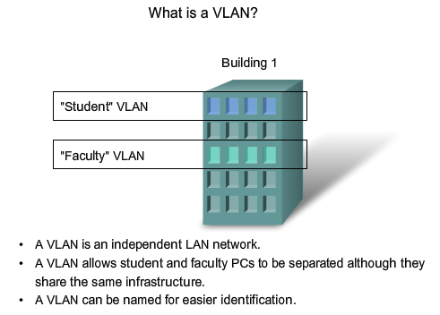
Explain the Role of VLANs in a Converged Network
Explain the role of VLANs in a converged network

Slide 4
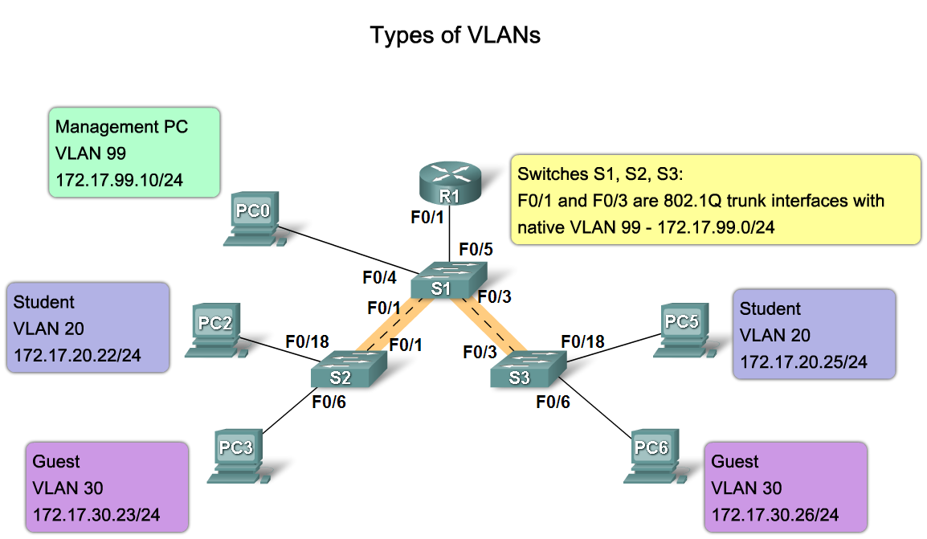
Explain the Role of VLANs in a Converged Network
Describe the different types VLANs

Slide 5
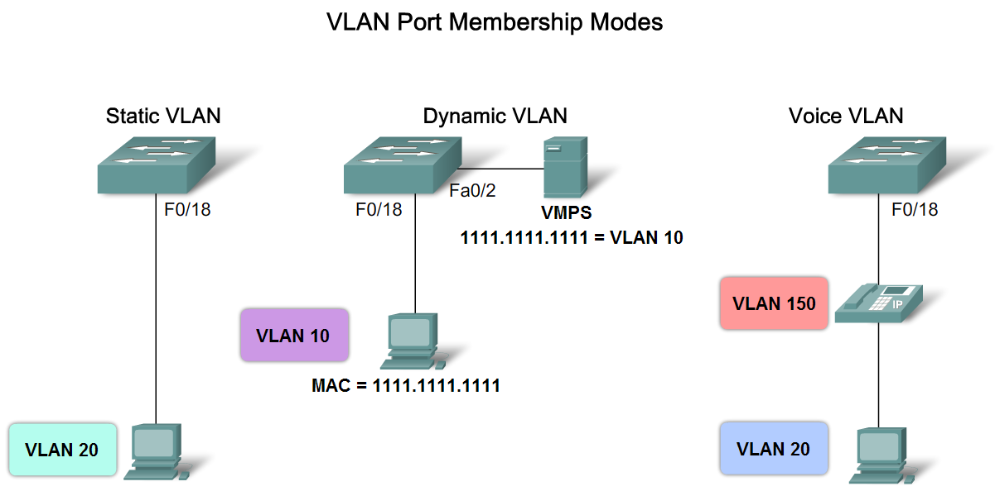
Explain the Role of VLANs in a Converged Network
Describe the VLAN port membership modes

Slide 6
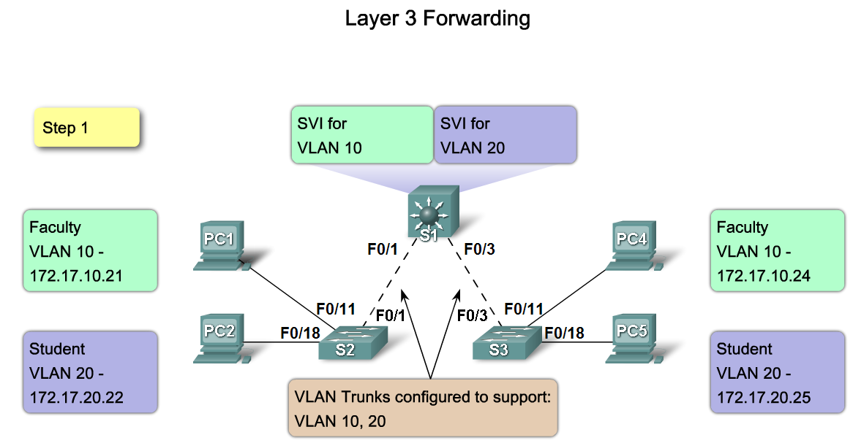
Explain the Role of VLANs in a Converged Network
Describe how to manage broadcast domains with VLANs

Slide 7
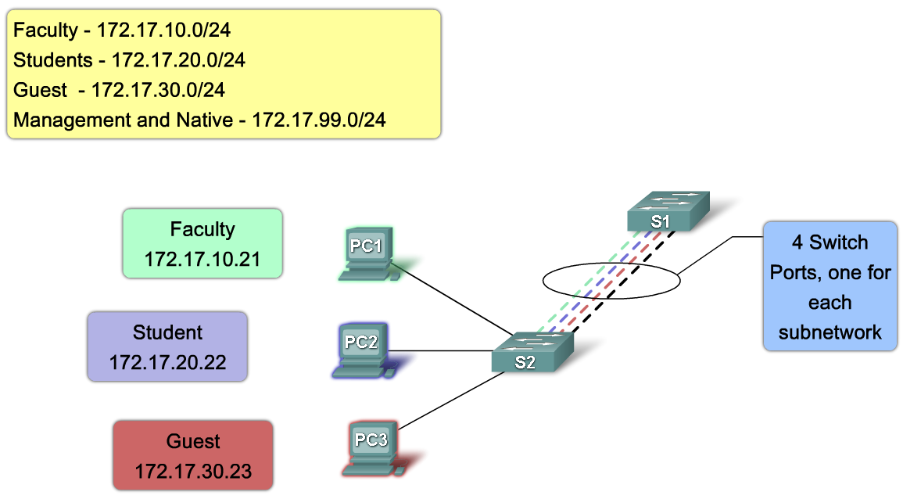
Explain the Role of Trunking VLANs in a Converged Network
Explain the role of a trunk when using multiple VLANs in a converged network

Slide 8
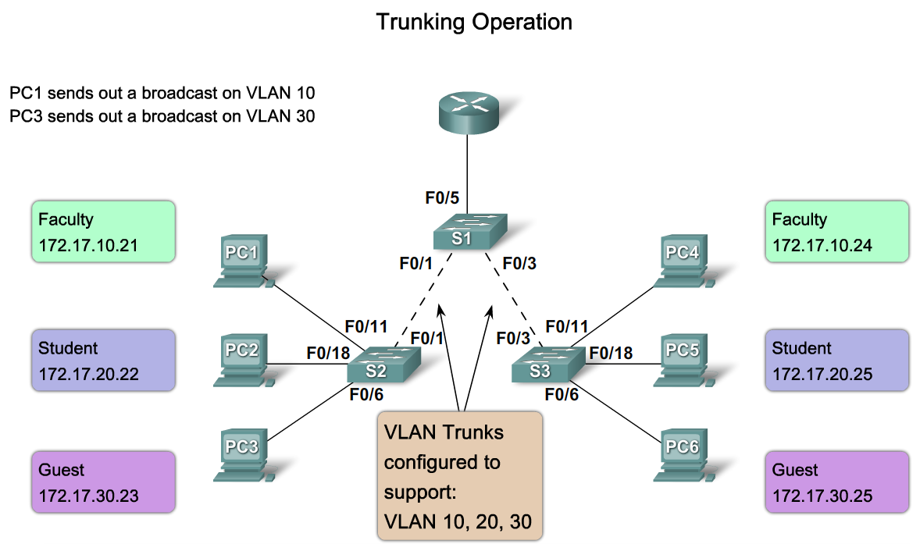
Explain the Role of Trunking VLANs in a Converged Network
Describe how a trunk works

Slide 9
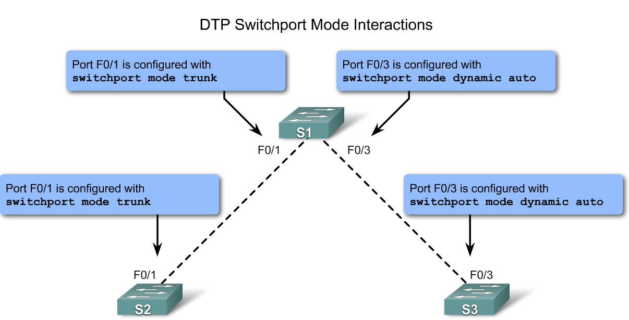
Explain the Role of Trunking VLANs in a Converged Network
Describe the switch port trunking modes

Slide 10
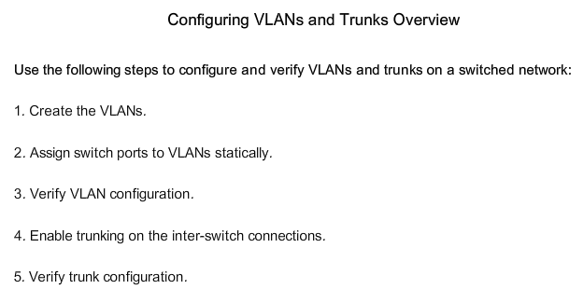
Configure VLANs on the Switches in a Converged Network Topology
Describe the steps to configure trunks and VLANs

Slide 11
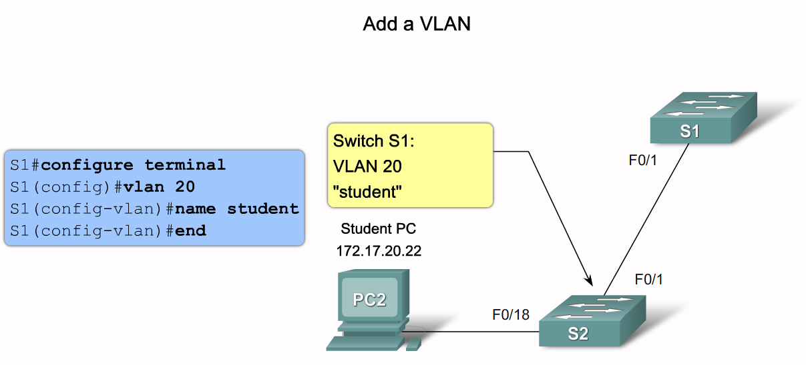
Configure VLANs on the Switches in a Converged Network Topology
Describe the Cisco IOS commands used to create a VLAN on a Cisco Catalyst switch

Slide 12
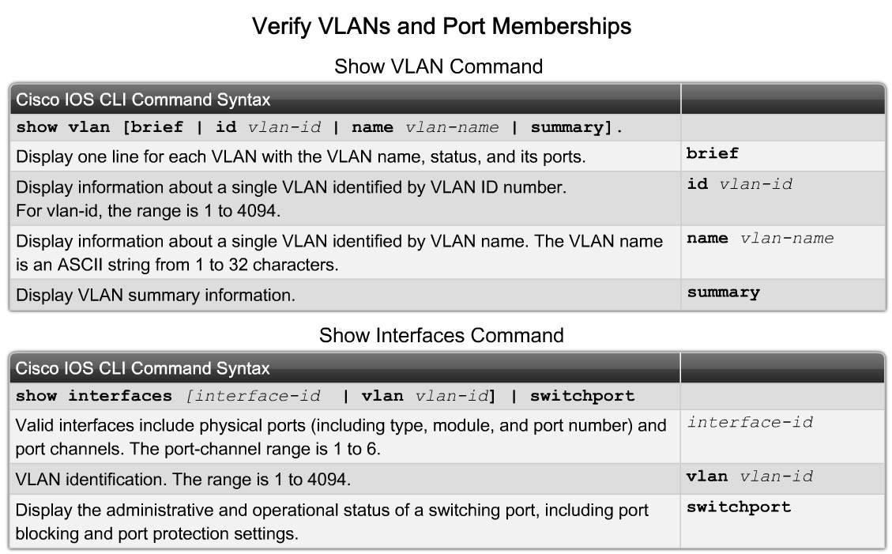
Configure VLANs on the Switches in a Converged Network Topology
Describe the Cisco IOS commands used to manage VLANs on a Cisco Catalyst switch

Slide 13
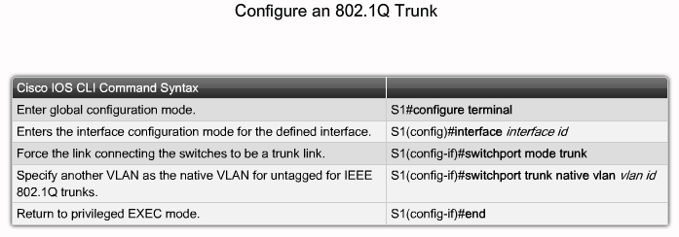
Configure VLANs on the Switches in a Converged Network Topology
Describe the Cisco IOS commands used to create a trunk on a Cisco Catalyst switch

Slide 14
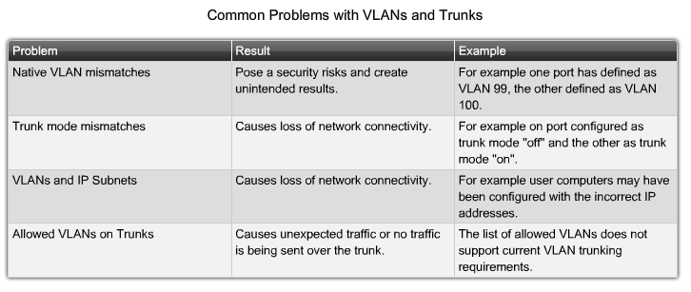
Troubleshoot Common Software or Hardware Misconfigurations Associated with VLANs
Describe the common problems with VLANs and trunks

Slide 15
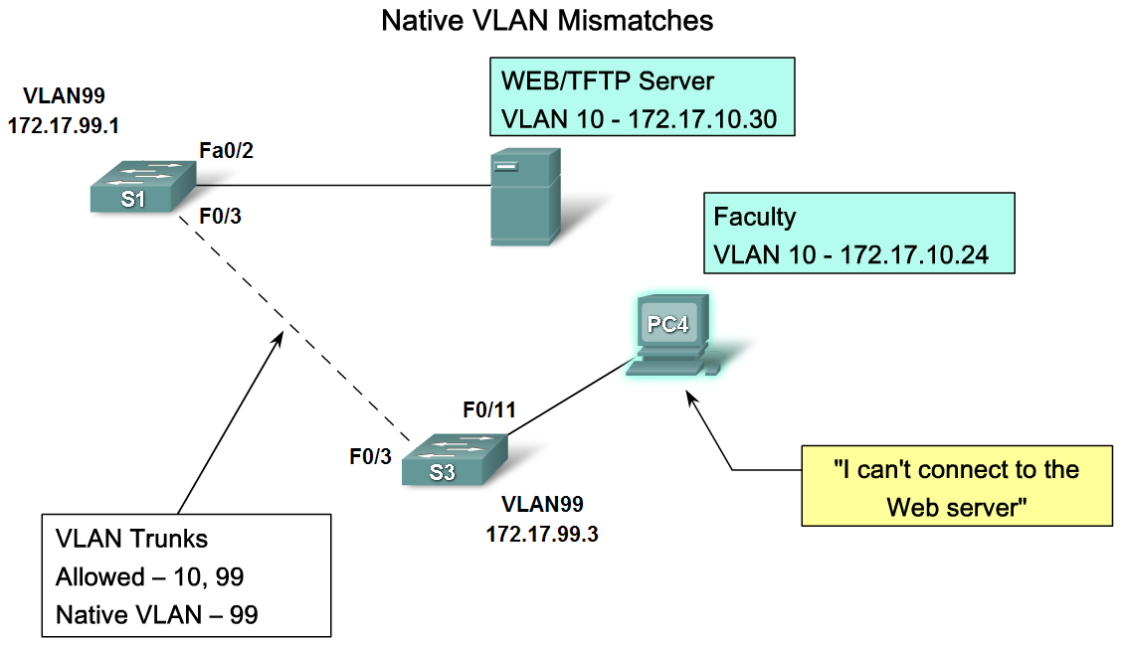
Troubleshoot Common Software or Hardware Misconfigurations Associated with VLANs
Describe the common problems with VLANs and trunks

Slide 16
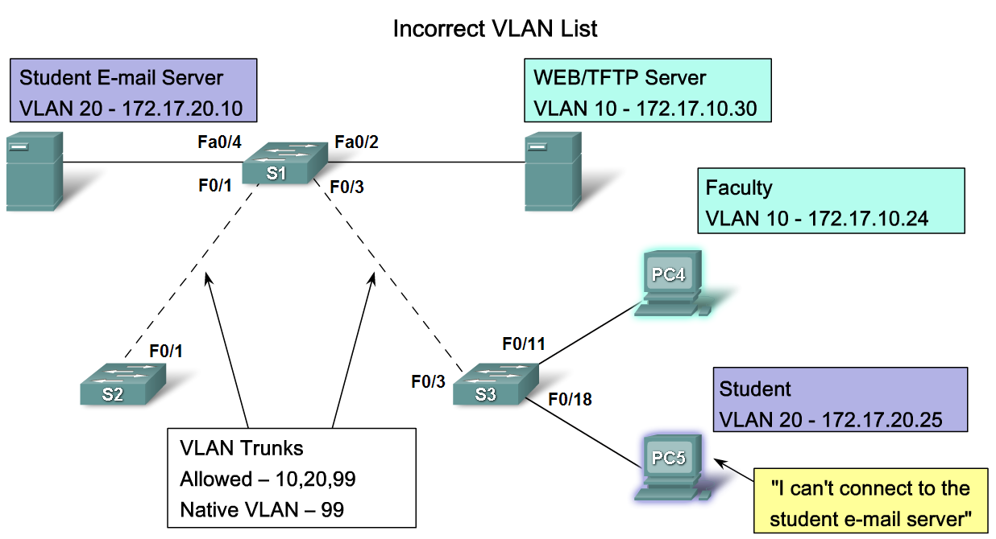
Troubleshoot Common Software or Hardware Misconfigurations Associated with VLANs
Describe how to use the troubleshooting procedure to fix a common problem with VLAN configurations

Slide 17
Summary
VLANS
Allows an administrator to logically group devices that act as their own network
Are used to segment broadcast domains
Some benefits of VLANs include
Cost reduction, security, higher performance, better management

Slide 18
Summary
Types of Traffic on a VLAN include
  Data
  Voice
  Network protocol
  Network management
Communication between different VLANs requires the use of
  Routers

Slide 19
Summary
Trunks
A common conduit used by multiple VLANS for intra-VLAN communication
EEE 802.1Q
The standard trunking protocol
Uses frame tagging to identify the VLAN to which a frame belongs
Does not tag native VLAN traffic

